Slide 1
Deep Learning
Music Generation
Riley Johnson

Slide 2

Hello!
I am Riley Johnson
My background is in Management, Consulting, and Finance
No experience in Music, Arts

Slide 3
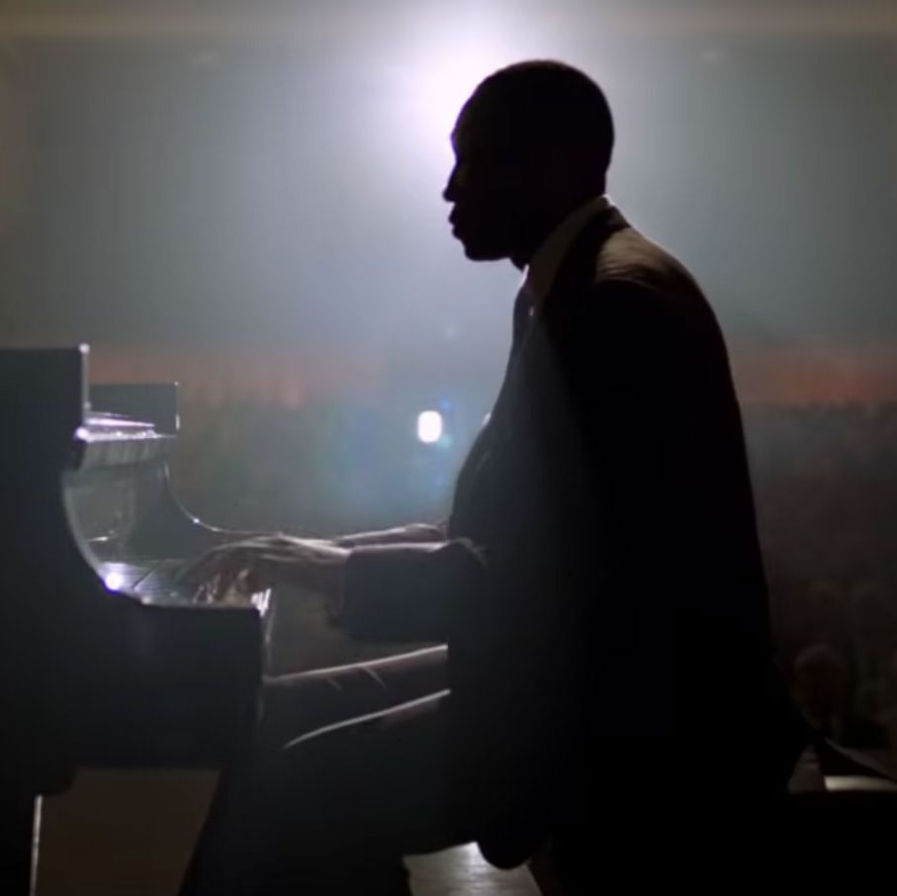
Motivation
For the non-artistic like myself, Deep learning creates an opportunity to still produce music
Everyone loves great music

Slide 4
Technical Challenge
Music is simply a combination of notes and chords
Based on a given sequence,
What is the most probable next note/chord

Slide 5
Tools
Jupyter Notebook
Keras
NumPy
Plotly
Music21
FreeMidi.Org

Slide 6
Overview
Input Data
Modeling
Prediction
Results
FEB
MAY

Slide 7
Overview
Input Data
Modeling
Prediction
Results
FEB

Slide 8



The Data
Single-instrument Piano MIDI Files
Pop Genre
87 Tracks
60 Unique Notes / Chords

Slide 9
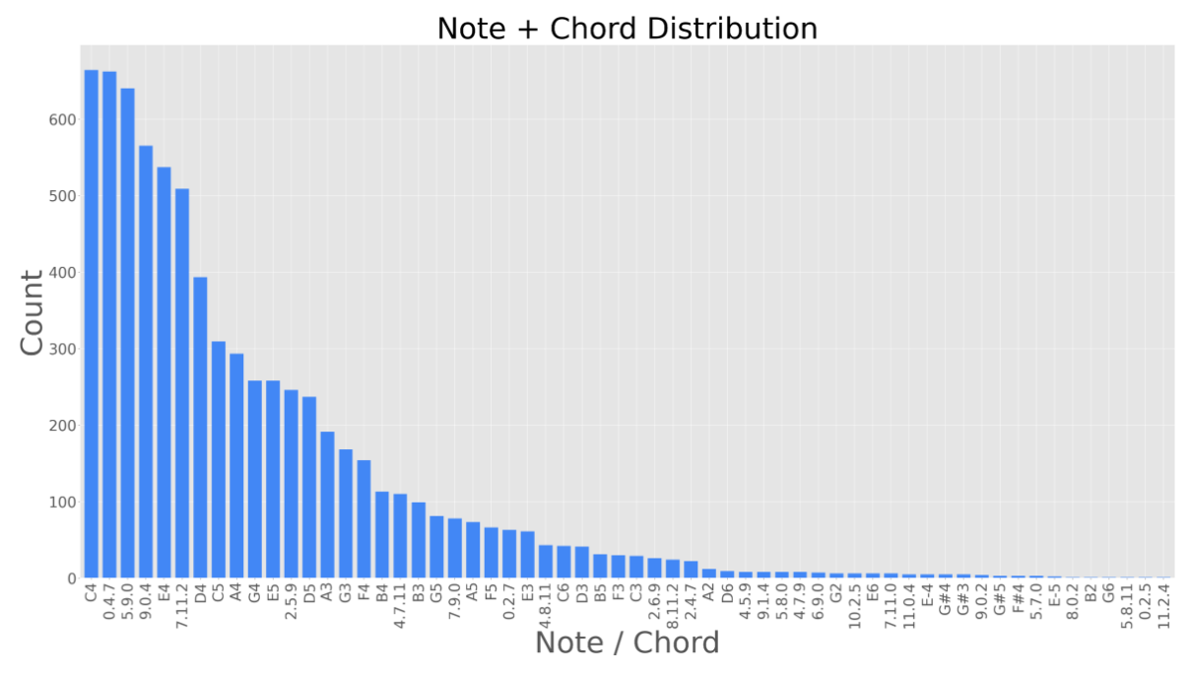

Slide 10
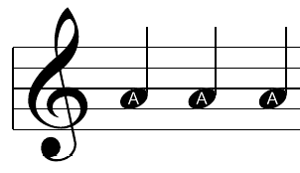
Encoding
Song

Slide 11

Encoding
Song
MIDI
A
A
A
G
G
G

Slide 12
Encoding
MIDI
(Categorical)
A
A
A
G
G

Slide 13
Encoding
MIDI
(Categorical)
One Hot Encode
A
A
A
[[1,0],[1,0],[1,0]]
G
G
G

Slide 14
Overview
Input Data
Modeling
Prediction
Results
FEB

Slide 15
Flow
LSTM has an internal state that updates at every time point, allowing information to persist
Able to recognize long term patterns
Aⱼ₊₁
LSTM
LSTM
LSTM
A₁
A₂
Aⱼ₊₁

Slide 16
Overview
Input Data
Modeling
Prediction
Results
FEB

Slide 17
Prediction
A
LSTM
For each input sequence, the learned weights determine the most probable next note

Slide 18
Prediction
A
LSTM
AB
For each input sequence, the learned weights determine the most probable next note

Slide 19
Prediction
A
LSTM
AB
LSTM
For each input sequence, the learned weights determine the most probable next note

Slide 20
Prediction
A
LSTM
AB
LSTM
ABC
For each input sequence, the learned weights determine the most probable next note
A song is produced by predicting one note at a time

Slide 21
Overview
Input Data
Modeling
Prediction
Results
FEB

Slide 22
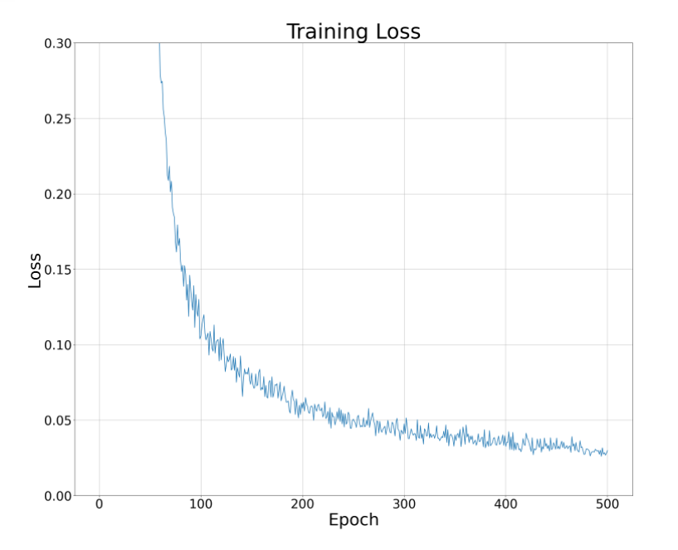
Loss

Slide 23
Loss

Slide 24
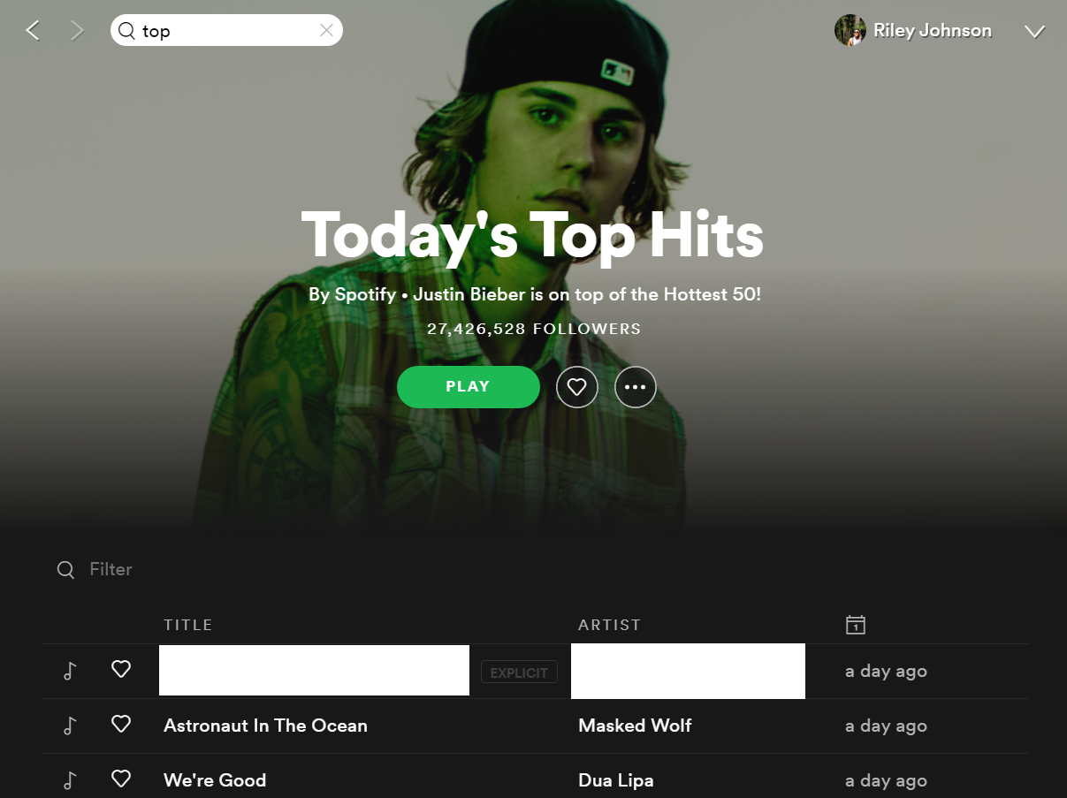
Result
Piano_Track_Final
Riley Johnson

Slide 25
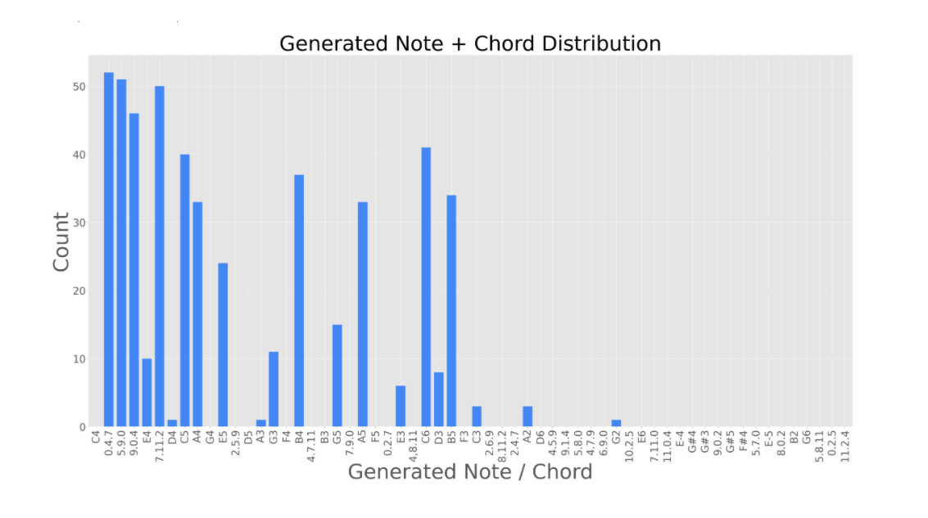

Slide 26
Results
Data Distribution
Generated Distribution

Slide 27
Conclusion
Challenges of working with song data: Difficult to evaluate. No accuracy or benchmarks
Hard to identify overfitting
Potential Copyright issues
Next time: expand to multi instruments or vocals

Slide 28
THANKS!
Any questions?

